Slide 1


Introduction to Attendance Monitoring
Enhancing attendance monitoring with facial recognition technology offers a seamless and efficient solution for various institutions. By integrating Python and OpenCV, the process becomes streamlined, ensuring accurate and reliable attendance records.

Slide 2

Challenges with Traditional Attendance Systems
Manual Data Entry: Time-consuming, prone to errors
Buddy Punching: Unauthorized proxies for attendance
Lack of Real-time Data: Hinders decision-making

Slide 3
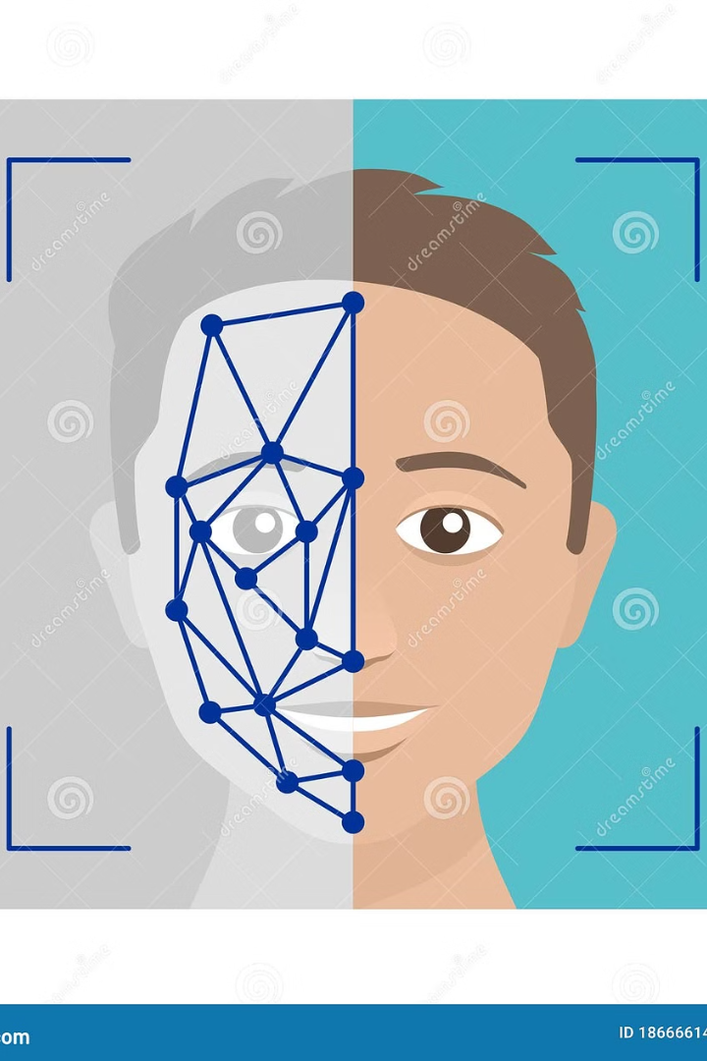
Abstract
Facial recognition technology uses biometrics to identify and verify individuals.
By analyzing unique facial features, it enhances security and enables personalized experiences.
Implementing facial recognition involves techniques like face detection, feature extraction, and machine learning.

Slide 4
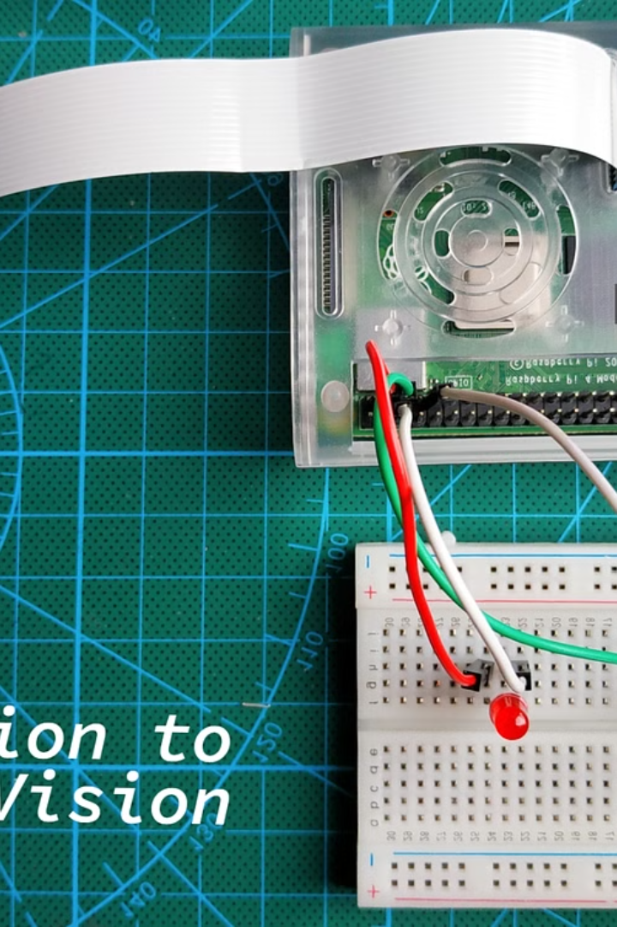
Introduction to OpenCV library
OpenCV (Open Source Computer Vision) is a powerful library for computer vision and machine learning. It provides a wide range of tools for image and video processing, including facial recognition, object detection, and more. It offers pre-trained models and a wide range of image processing functions

Slide 5
Problem Statement
The problem statement of face recognition typically involves developing algorithms and systems that can accurately identify and verify individuals based on facial characteristics captured in images or videos. Here's a more detailed breakdown of the problem statement:
Objective: The primary objective of face recognition is to develop algorithms and systems that can automatically identify and verify individuals based on their facial features.
Input: The input to a face recognition system is usually an image or video frame containing one or more human faces.
Output: The output of the system is the identification or verification of the individual(s) present in the input image or video frame. This could be in the form of a label (e.g., person's name or ID) associated with each detected face.

Slide 6

Solution Statement
It supports multiple programming paradigms and has a vast standard library, making it suitable for various applications. The goal is to create efficient and reliable solutions that can handle variability in appearance, large datasets, privacy concerns, and real-time processing requirements. Face recognition finds applications in security, surveillance, biometric authentication, and personalization.
Techniques range from traditional methods like Eigenfaces to deep learning approaches such as convolutional neural networks (CNNs). Evaluation metrics include accuracy, precision, recall, and computational efficiency.

Slide 7
Training the Facial Recognition Model
1
Data Collection
Gather a diverse set of facial images to train the model.
2
Image Preprocessing
Normalize and enhance the quality of facial images for training.
3
Model Training
Utilize machine learning algorithms to train the facial recognition model.

Slide 8
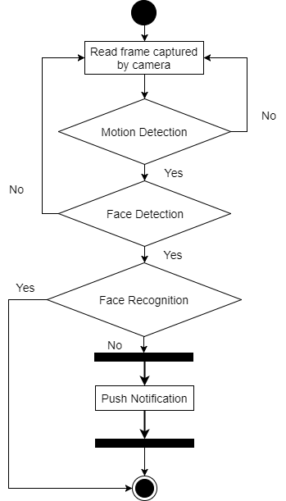
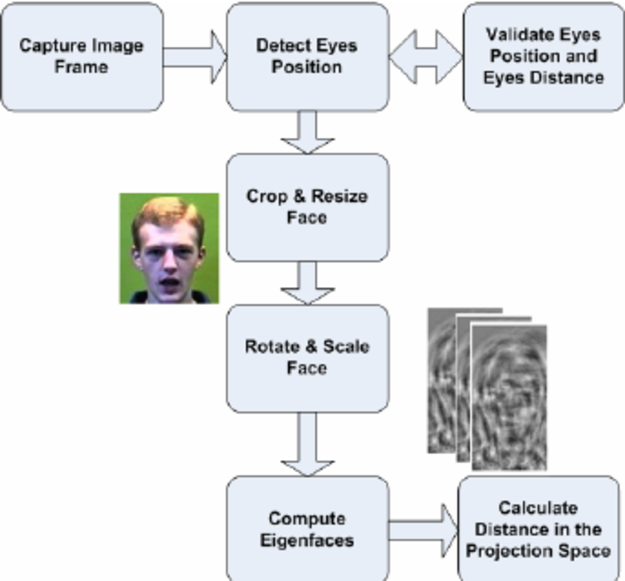
DATA FLOW DIAGRAM
Design Phase Diagrams
DATA FLOW DIAGRAM ACTIVITY DIAGRAM
ACTIVITY DIAGRAM ACTIVITY DIAGRAM ACTIVITY DIAGRAM

Slide 9

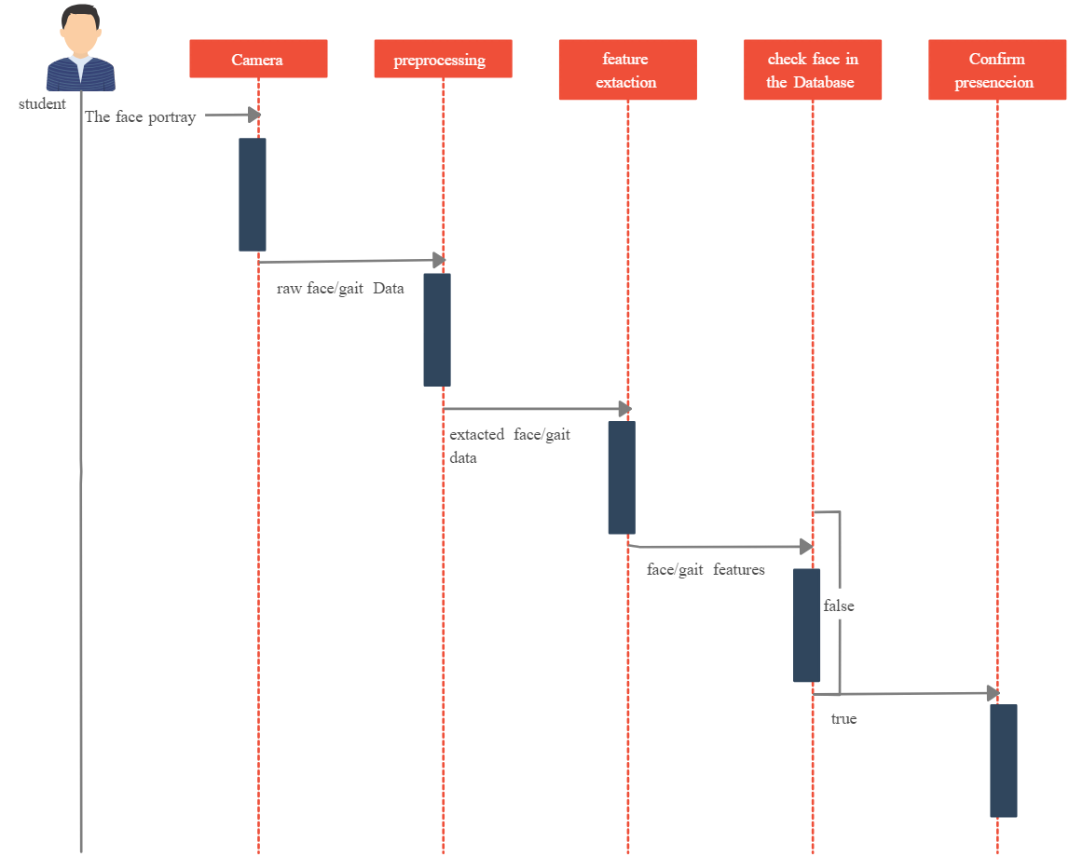
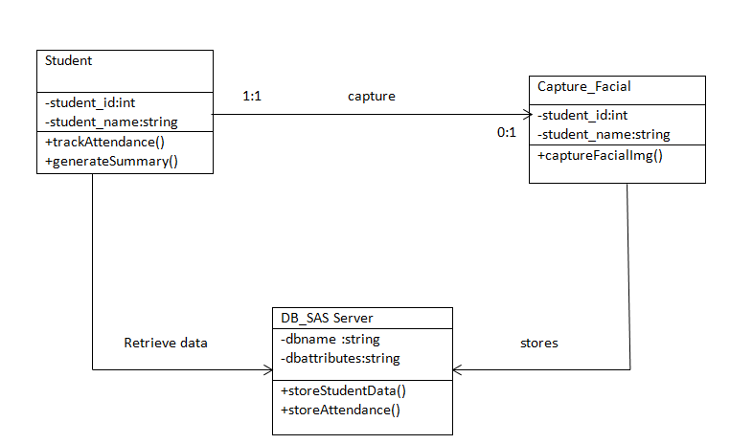
FLOW DIAGRAM CLASS DIAGRAM

Slide 10
Code:
import cv2
import face_recognition
import os
import numpy as np
from datetime import datetime
import pickle
# Define a folder path where your training image dataset will be stored
path = "student_images"
# Create a list to store person_name and image array
# Traverse all image files present in the path directory, read images,
# and append the image array to the image list and file name to classNames.
images = []
classNames = []
mylist = os.listdir(path)
# Call the function to compute face encodings for your training images
encoded_face_train = findEncodings(images)
# Create a function that will create a Attendance.csv file to store the attendance with time
# Initialize an empty set to store recorded names
recorded_names = set()
def markAttendance(name):
global recorded_names # Use the global set
cv2.rectangle(img, (x1, y1), (x2, y2), (0, 255, 0), 2)
cv2.rectangle(img, (x1, y2 - 35), (x2, y2), (0, 255, 0), cv2.FILLED)
cv2.putText(img, name, (x1 + 6, y2 - 5), cv2.FONT_HERSHEY_COMPLEX, 1, (255, 255, 255), 2)
markAttendance(name)
cv2.imshow('webcam', img)
if cv2.waitKey(1) & 0xFF == ord('q'): # Change waitKey delay to 1 ms
break
# Release the video capture object and close the OpenCV window
cap.release()
cv2.destroyAllWindows()

Slide 11
Code:
if name not in recorded_names:
# Record attendance
with open('Attendance.csv', 'a') as f:
now = datetime.now()
time = now.strftime('%I:%M:%S %p')
date = now.strftime('%d-%B-%Y')
f.write(f'{name}, {time}, {date}\n')
# Add the name to the set of recorded names
recorded_names.add(name)
# take pictures from webcam
cap = cv2.VideoCapture(0)
while True:
success, img = cap.read()
imgS = cv2.resize(img, (0, 0), None, 0.25, 0.25)
imgS = cv2.cvtColor(imgS, cv2.COLOR_BGR2RGB)
faces_in_frame = face_recognition.face_locations(imgS)
encoded_faces = face_recognition.face_encodings(imgS, faces_in_frame)
for encode_face, faceloc in zip(encoded_faces, faces_in_frame):
faceDist = face_recognition.face_distance(encoded_face_train, encode_face)
matchIndex = np.argmin(faceDist)
if faceDist[matchIndex] < 0.6: # Set a threshold for face distance
name = classNames[matchIndex].upper().lower()
y1, x2, y2, x1 = faceloc
y1, x2, y2, x1 = y1 * 4, x2 * 4, y2 * 4, x1 * 4

Slide 12
Code:
cv2.rectangle(img, (x1, y1), (x2, y2), (0, 255, 0), 2)
cv2.rectangle(img, (x1, y2 - 35), (x2, y2), (0, 255, 0), cv2.FILLED)
cv2.putText(img, name, (x1 + 6, y2 - 5), cv2.FONT_HERSHEY_COMPLEX, 1, (255, 255, 255), 2)
markAttendance(name)
cv2.imshow('webcam', img)
if cv2.waitKey(1) & 0xFF == ord('q'): # Change waitKey delay to 1 ms
break
# Release the video capture object and close the OpenCV window
cap.release()
cv2.destroyAllWindows()

Slide 13
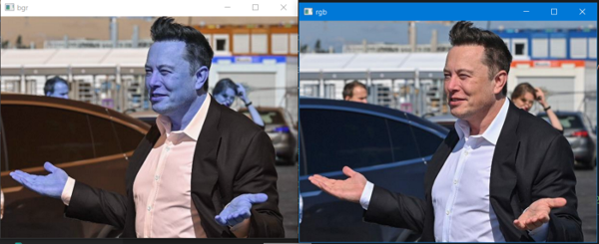
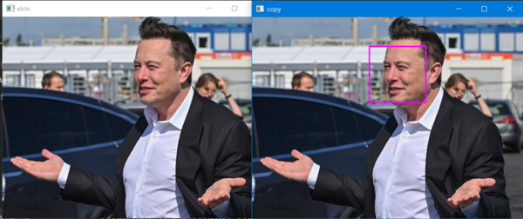
s
Project snapshots
As you see, RGB looks natural, so you will always change the channel to RGB.
After conversion to RGB detection of face is being done.

Slide 14

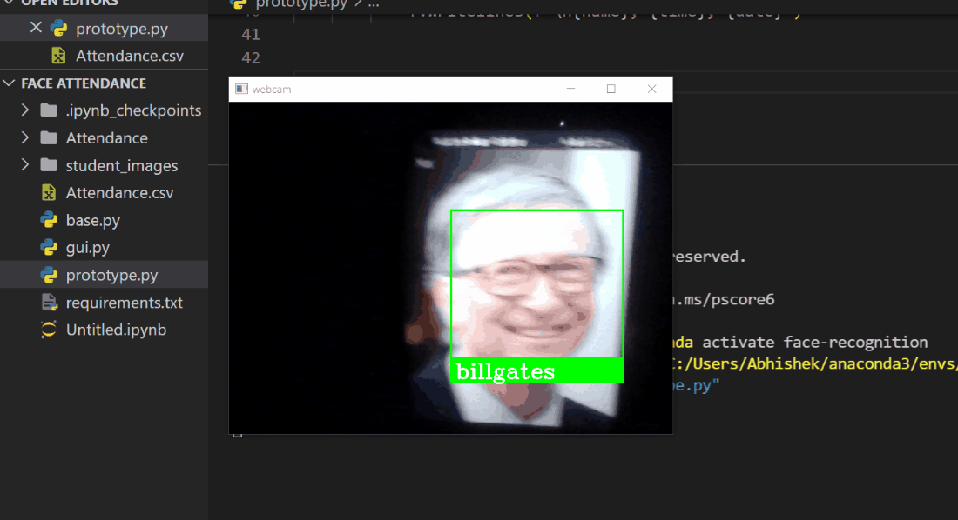
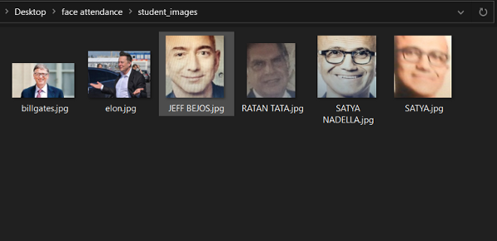
More to Know
Facial recognition technology not only improves attendance monitoring but also enhances security. By accurately identifying individuals, it prevents unauthorized access and ensures only authorized personnel can enter restricted areas.

Slide 15
Conclusions and Potential Applications of Facial Recognition Technology in Attendance Monitoring
Enhanced Security
Streamlined Processes
Facial recognition technology provides a secure and accurate way to verify the identity of individuals, reducing the risk of unauthorized attendance records.
Automated attendance monitoring using facial recognition streamlines the check-in process, saving time and eliminating the need for manual record-keeping.
Improved Accuracy
Real-time Monitoring
The technology ensures precise attendance tracking, minimizing errors and enhancing overall data accuracy for administrative purposes.
Facial recognition enables real-time monitoring of attendance, allowing for immediate intervention and insights into attendance patterns.

Slide 16

Exploring Advancements in Facial Recognition Technology for future scopes
As technology continues to evolve, the future scope of facial recognition in attendance monitoring looks promising. Advancements in machine learning algorithms, hardware, and data processing capabilities open up possibilities for improved accuracy, real-time monitoring, and integration with other systems.
Facial recognition technology provides numerous benefits for attendance monitoring. It offers a touchless and contactless solution, enhancing hygiene and safety. With its high accuracy and speed, it eliminates the need for manual attendance tracking, saving time and resources. Moreover, facial recognition ensures reliable and tamper-proof attendance records, promoting transparency and accountability.

Slide 17

References
Facial recognition technology provides numerous benefits for attendance monitoring. It offers a touchless and contactless solution, enhancing hygiene and safety.Moreover, facial recognition ensures reliable and tamper-proof attendance records, promoting transparency and accountability.
Research Papers
https://www.researchgate.net/publication/326261079_Face_detection_ system_for_attendance_of_class’_students [2] Hapani, Smit, et al. "Automated Attendance System Using Image Processing." 2018 Fourth International Conference on Computing Communication Control and Automation (ICCUBEA). IEEE, 2018. [3] Akbar, Md Sajid, et al. "Face Recognition and RFID Verified Attendance System." 2018 International Conference on Computing, Electronics & Communications Engineering (iCCECE). IEEE, 2018. [4] Okokpujie, Kennedy O., et al. "Design and implementation of a student attendance system using iris biometric recognition." 2017 International Conference on Computational Science and Computational Intelligence (CSCI). IEEE, 2017.

